Slide 1
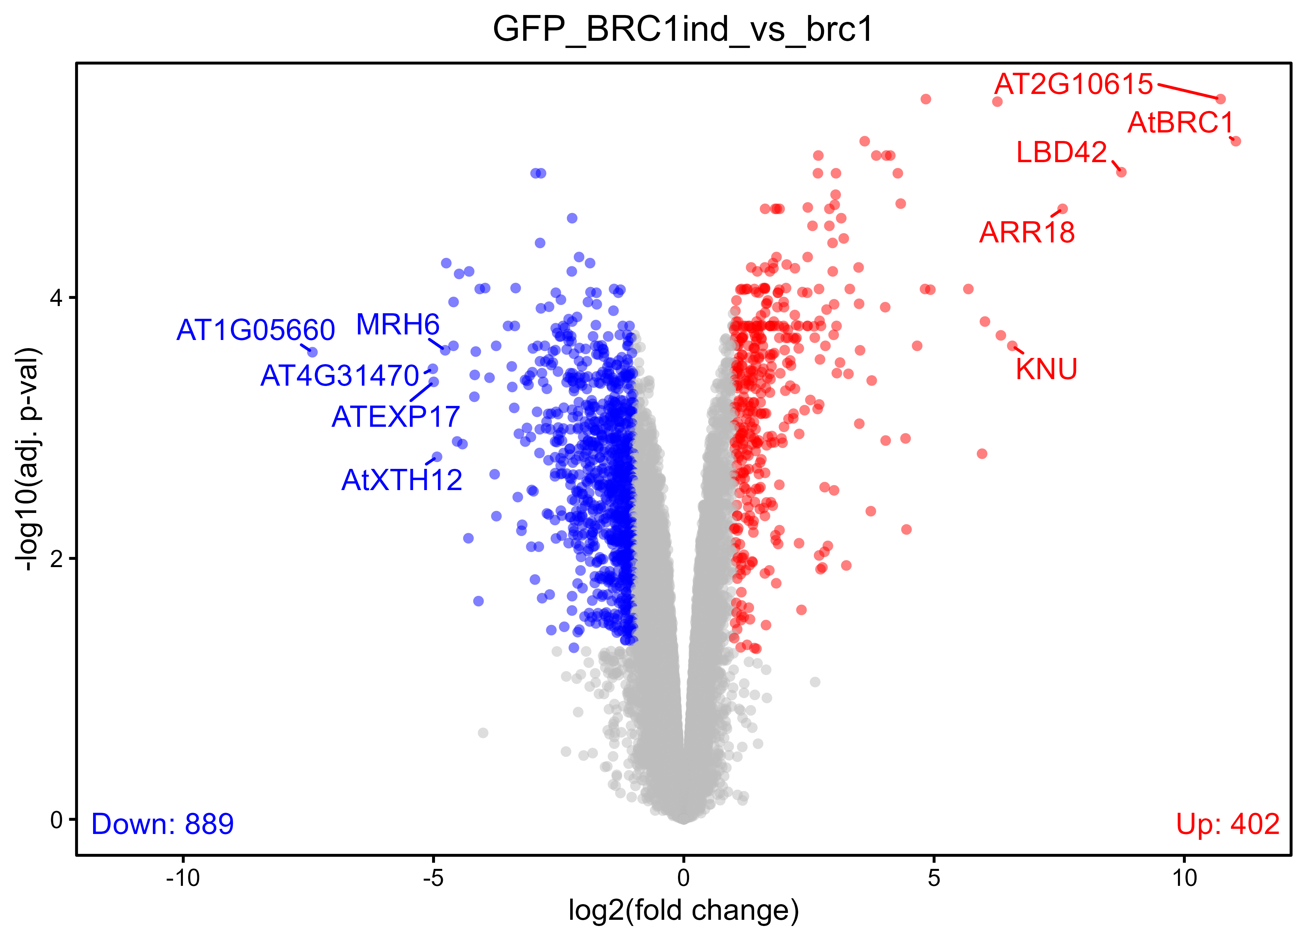
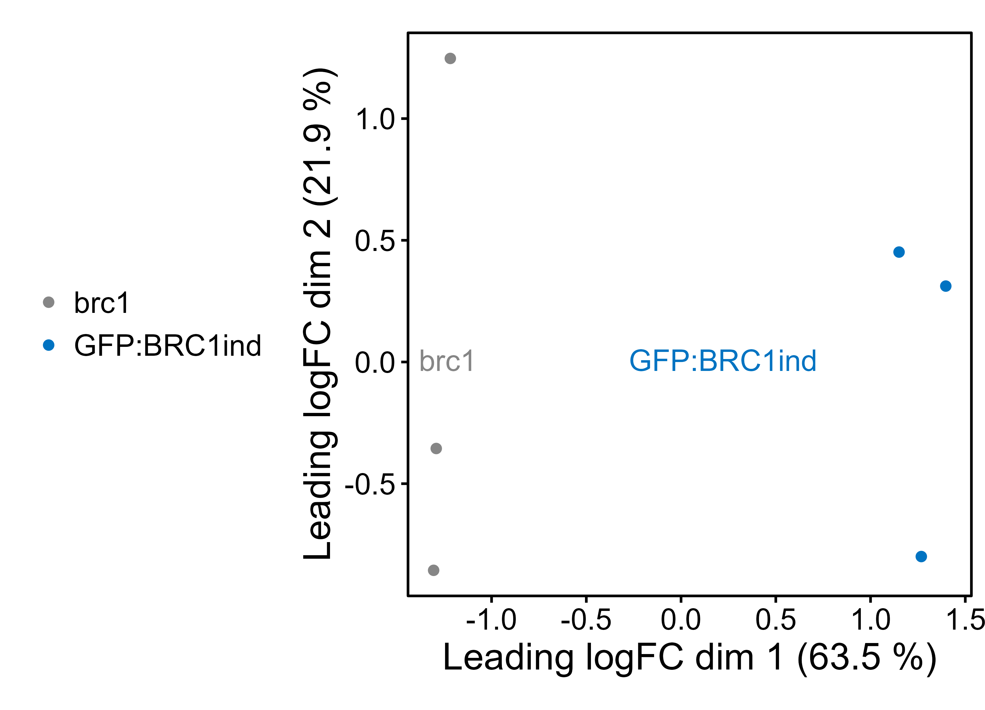
Quality check and data exploration (GFP:BRC1ind)

Slide 2
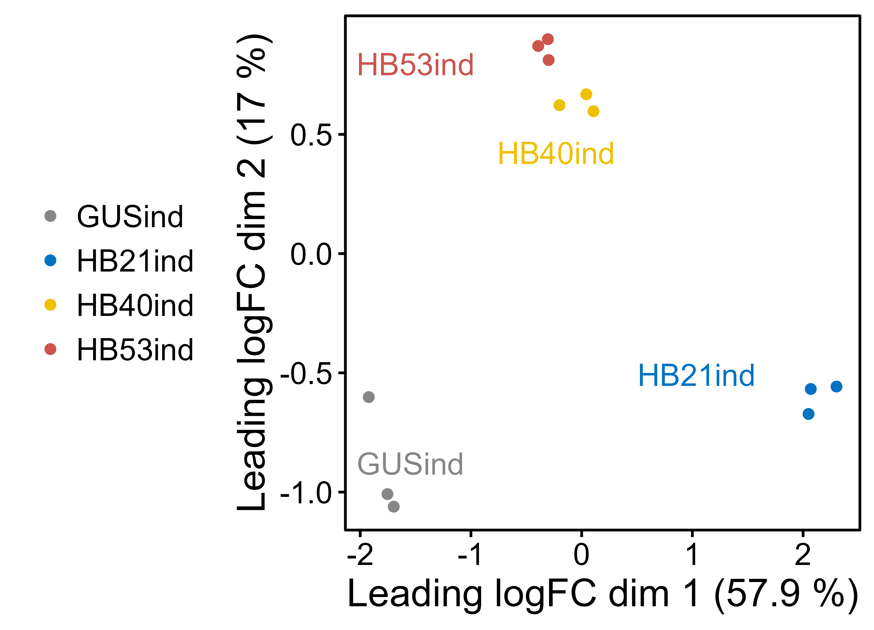
Quality check and data exploration (HBind)

Slide 3
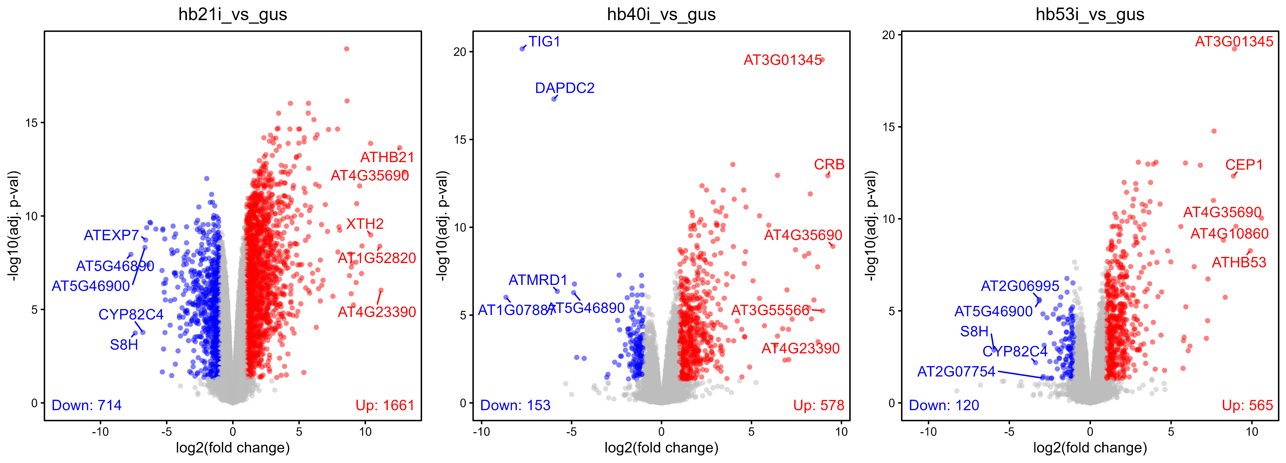
Quality check and data exploration (HBind)

Slide 4
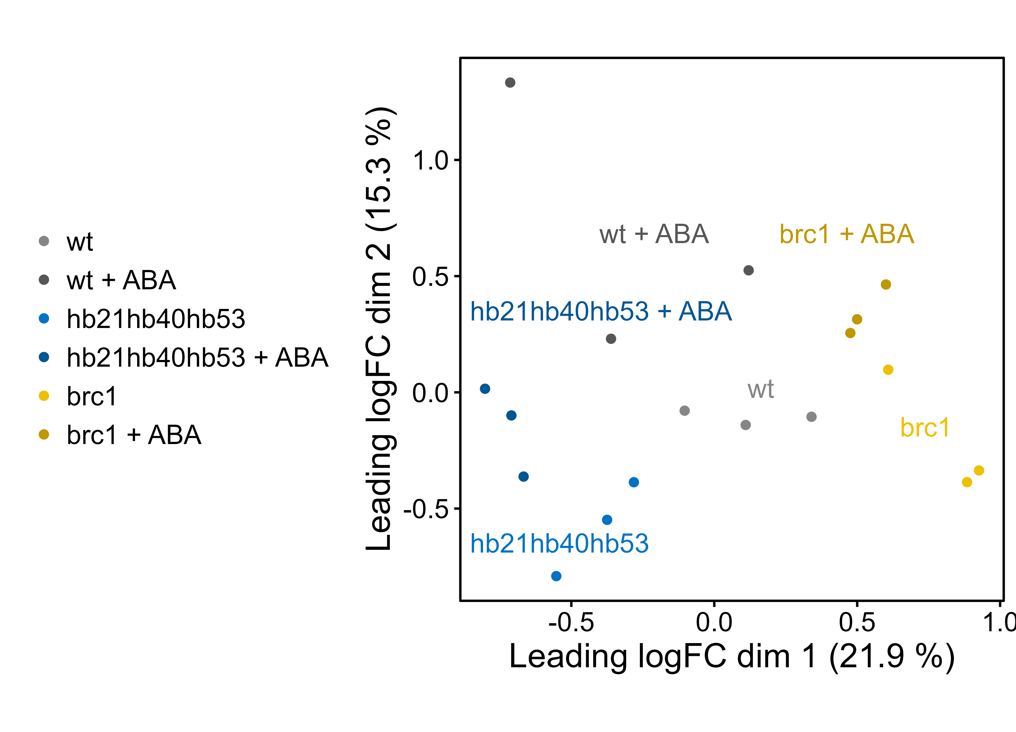
Quality check and data exploration (ABA experiment)

Slide 5
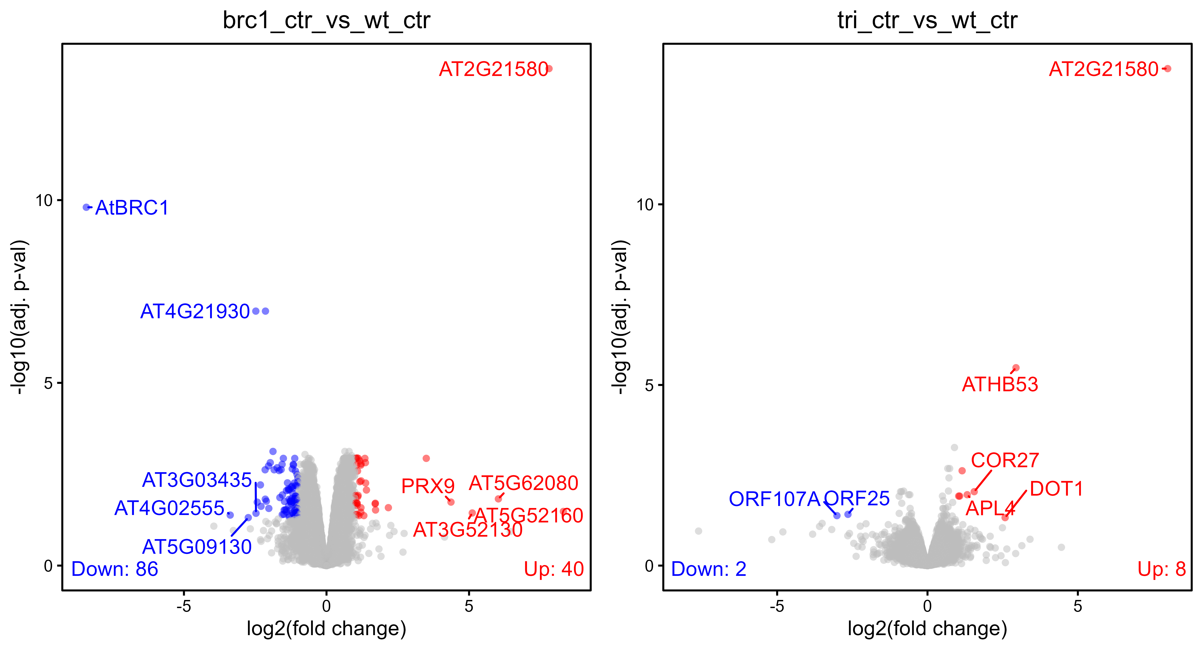
Quality check and data exploration (ABA experiment)

Slide 6
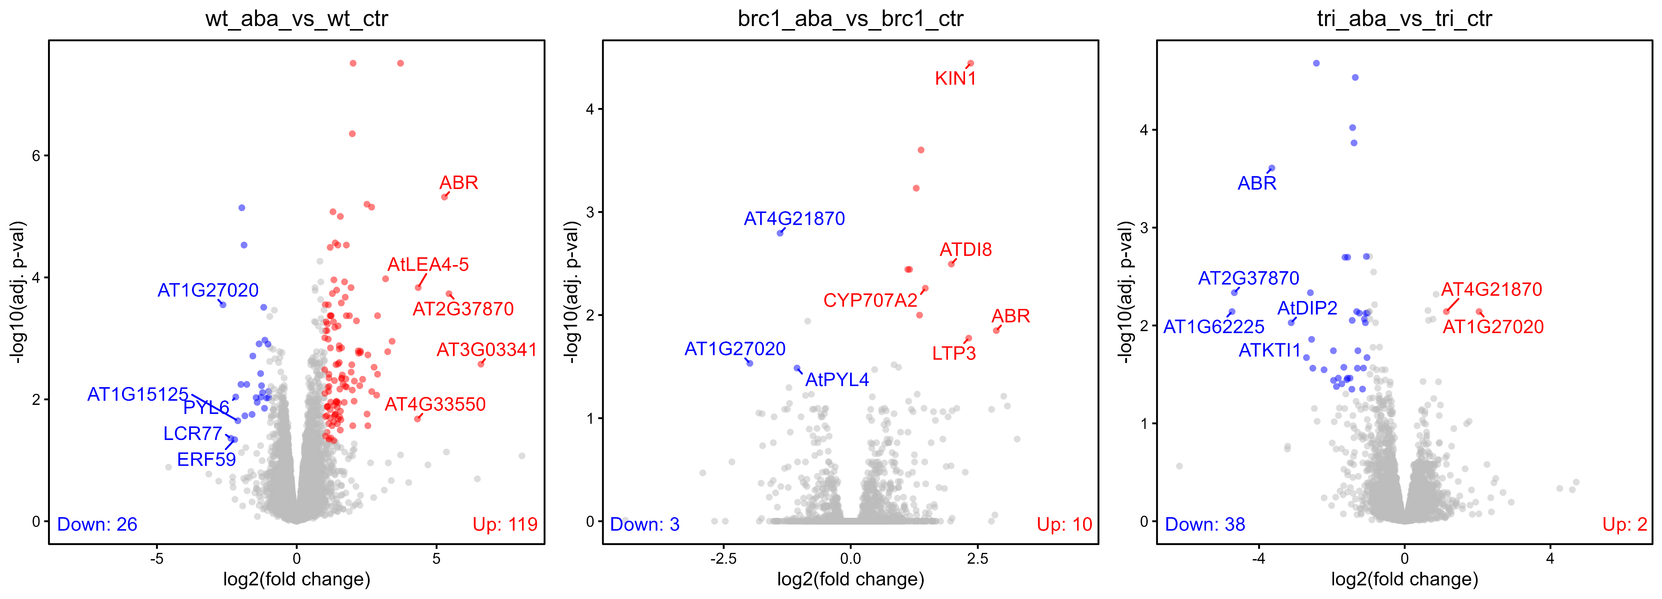
Quality check and data exploration (ABA experiment)

Slide 7
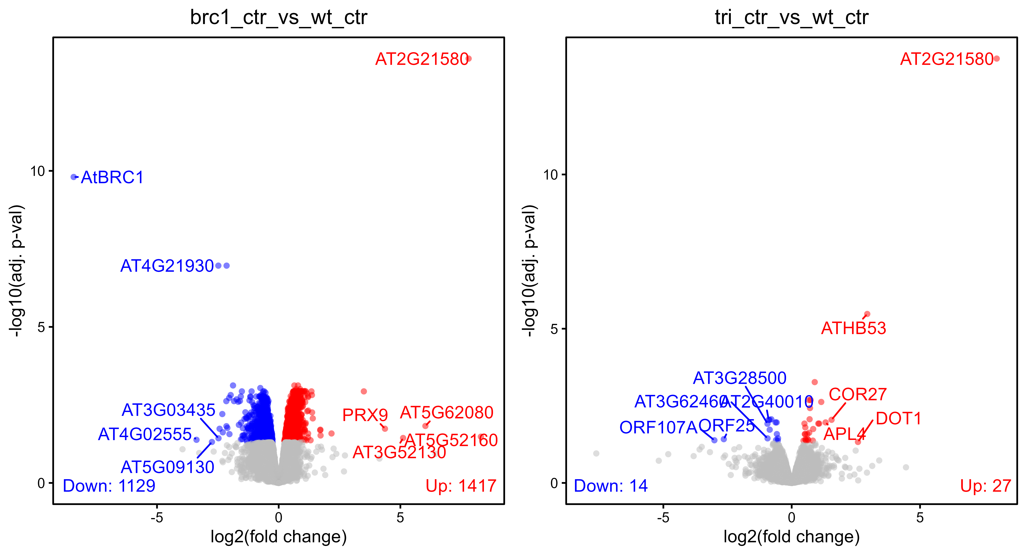
Quality check and data exploration (ABA experiment – no FC threshold)

Slide 8
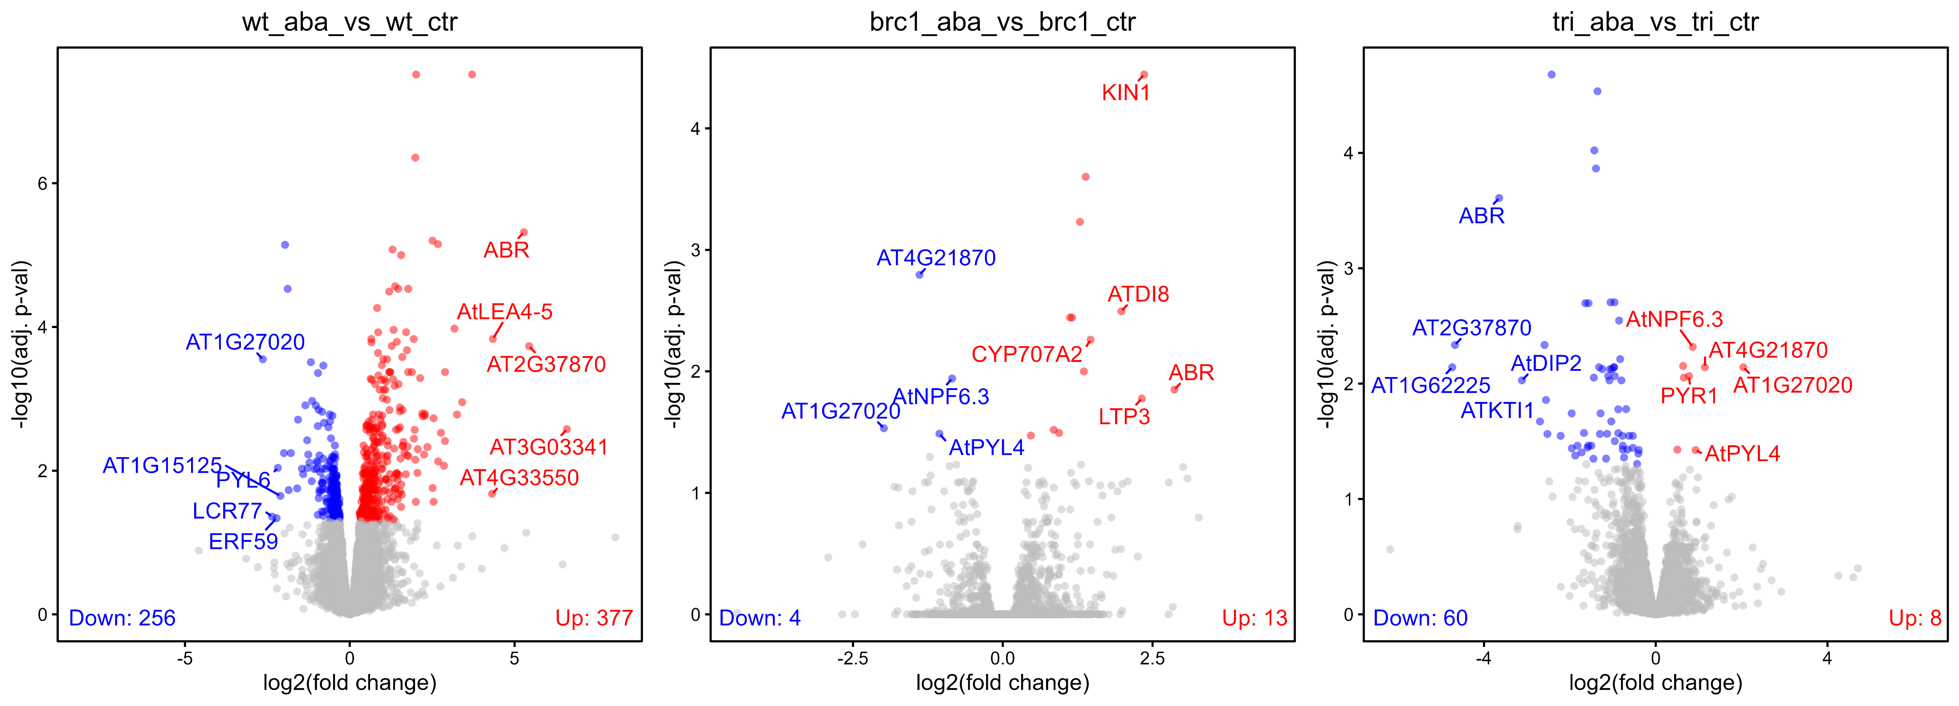
Quality check and data exploration (ABA experiment – no FC threshold)

Slide 9
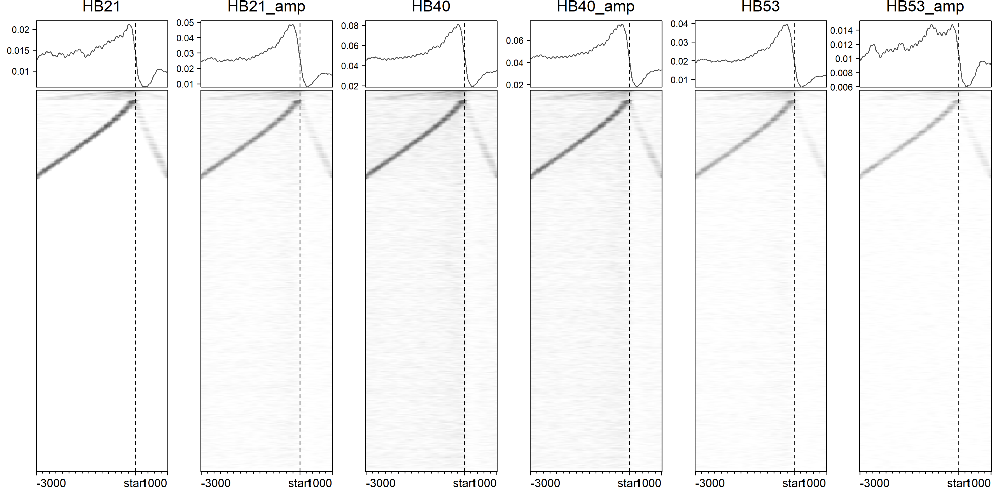

Slide 10
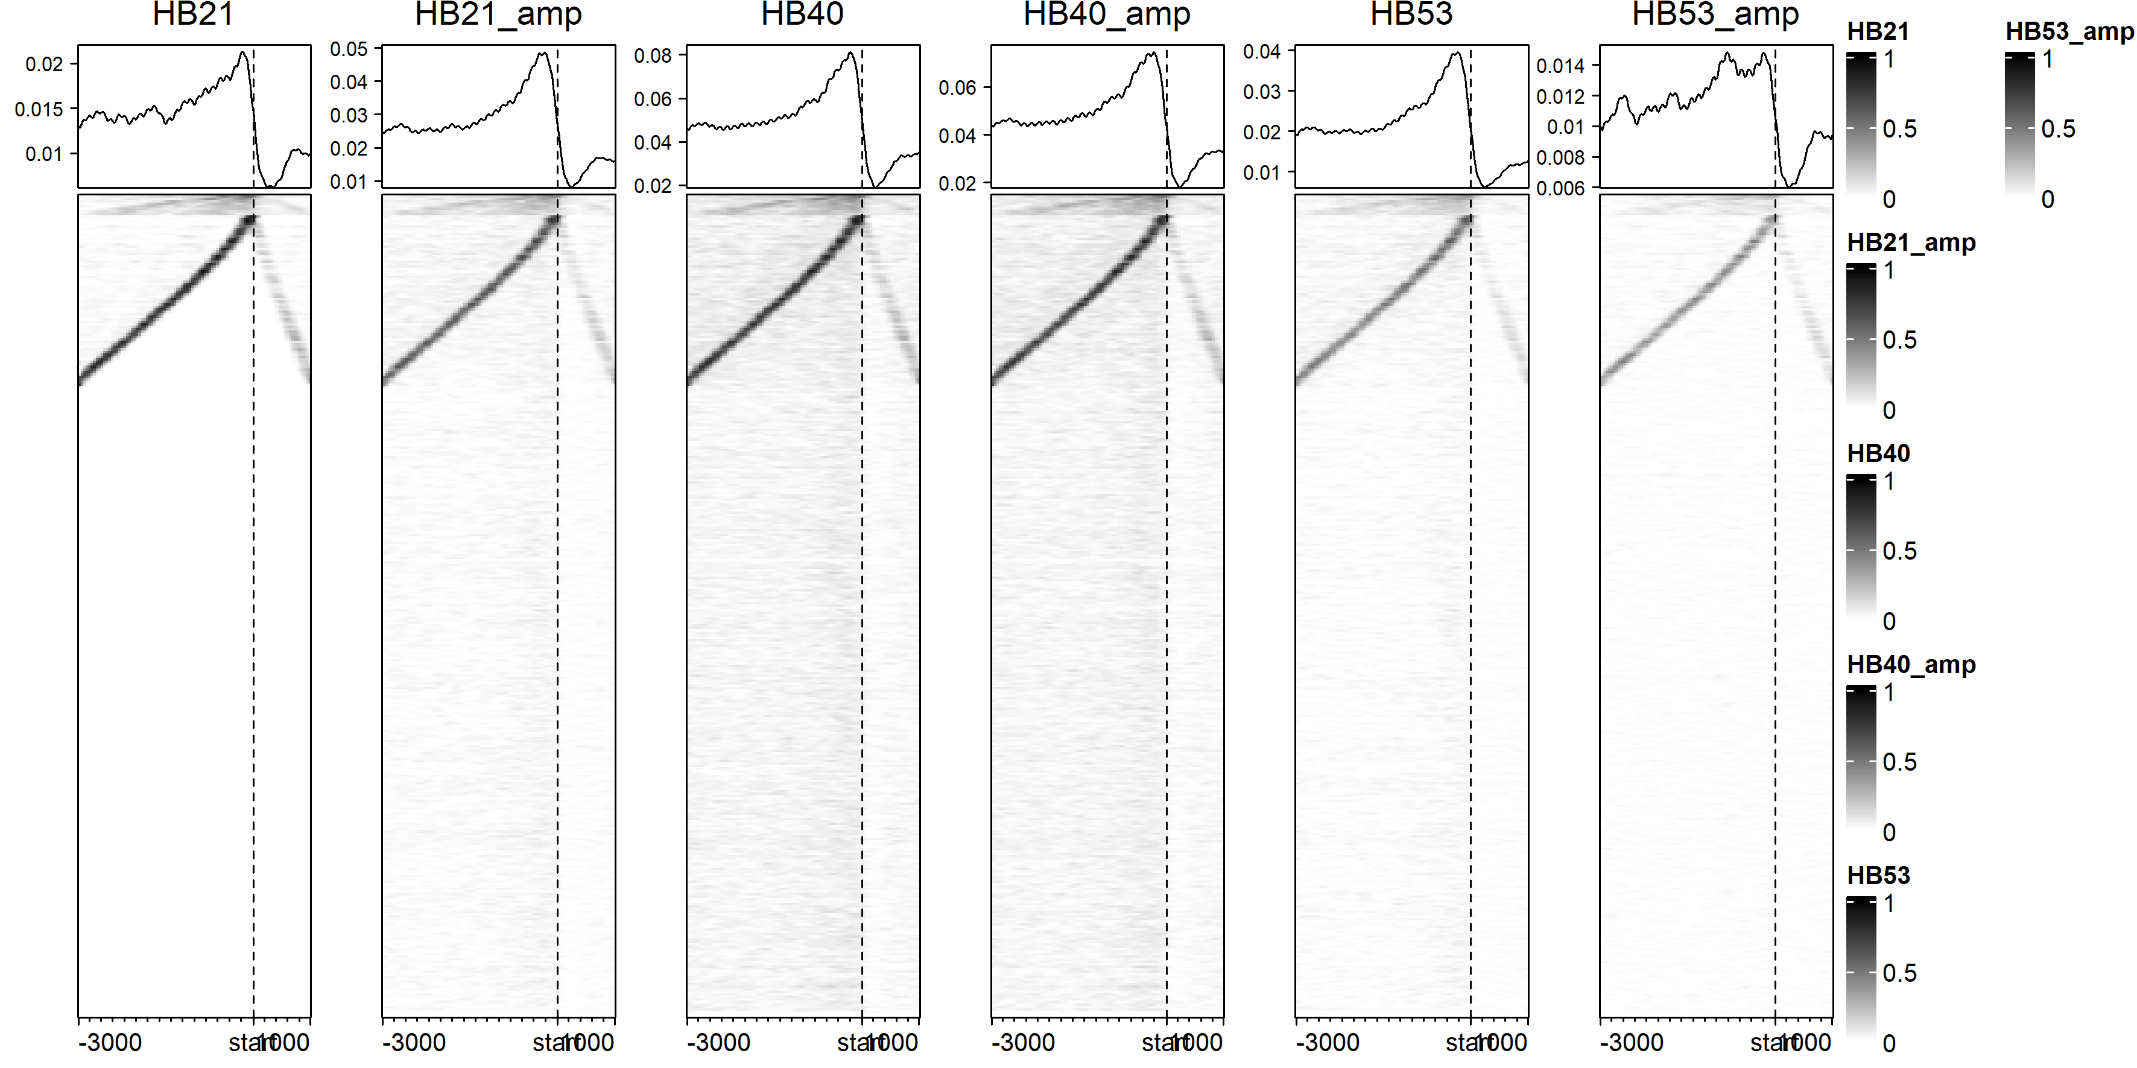

Slide 11
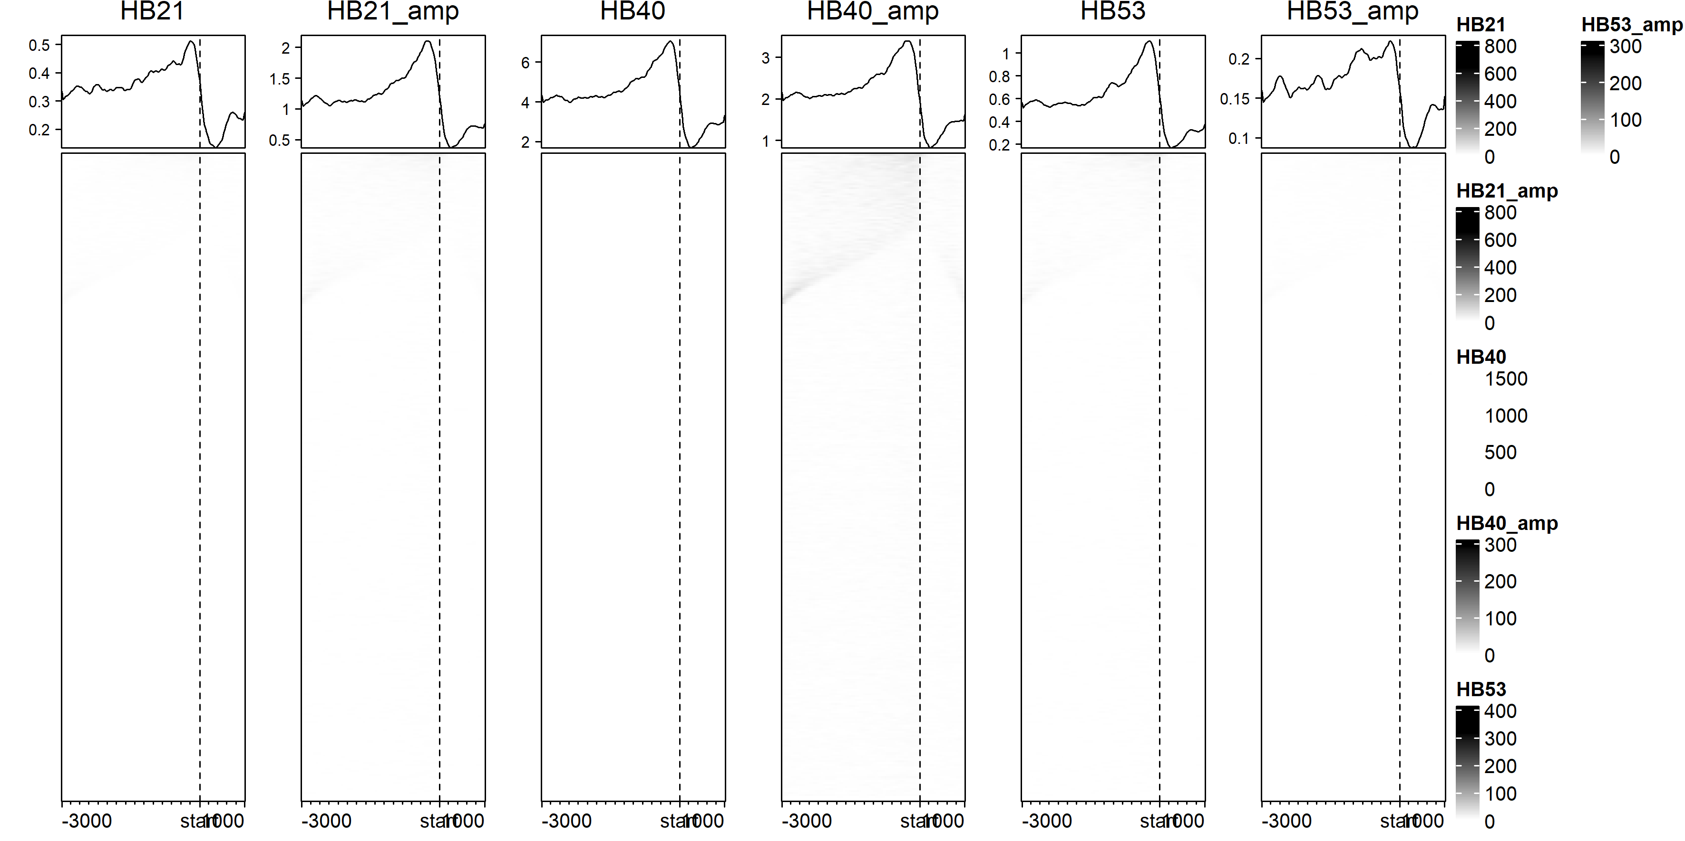

Slide 12
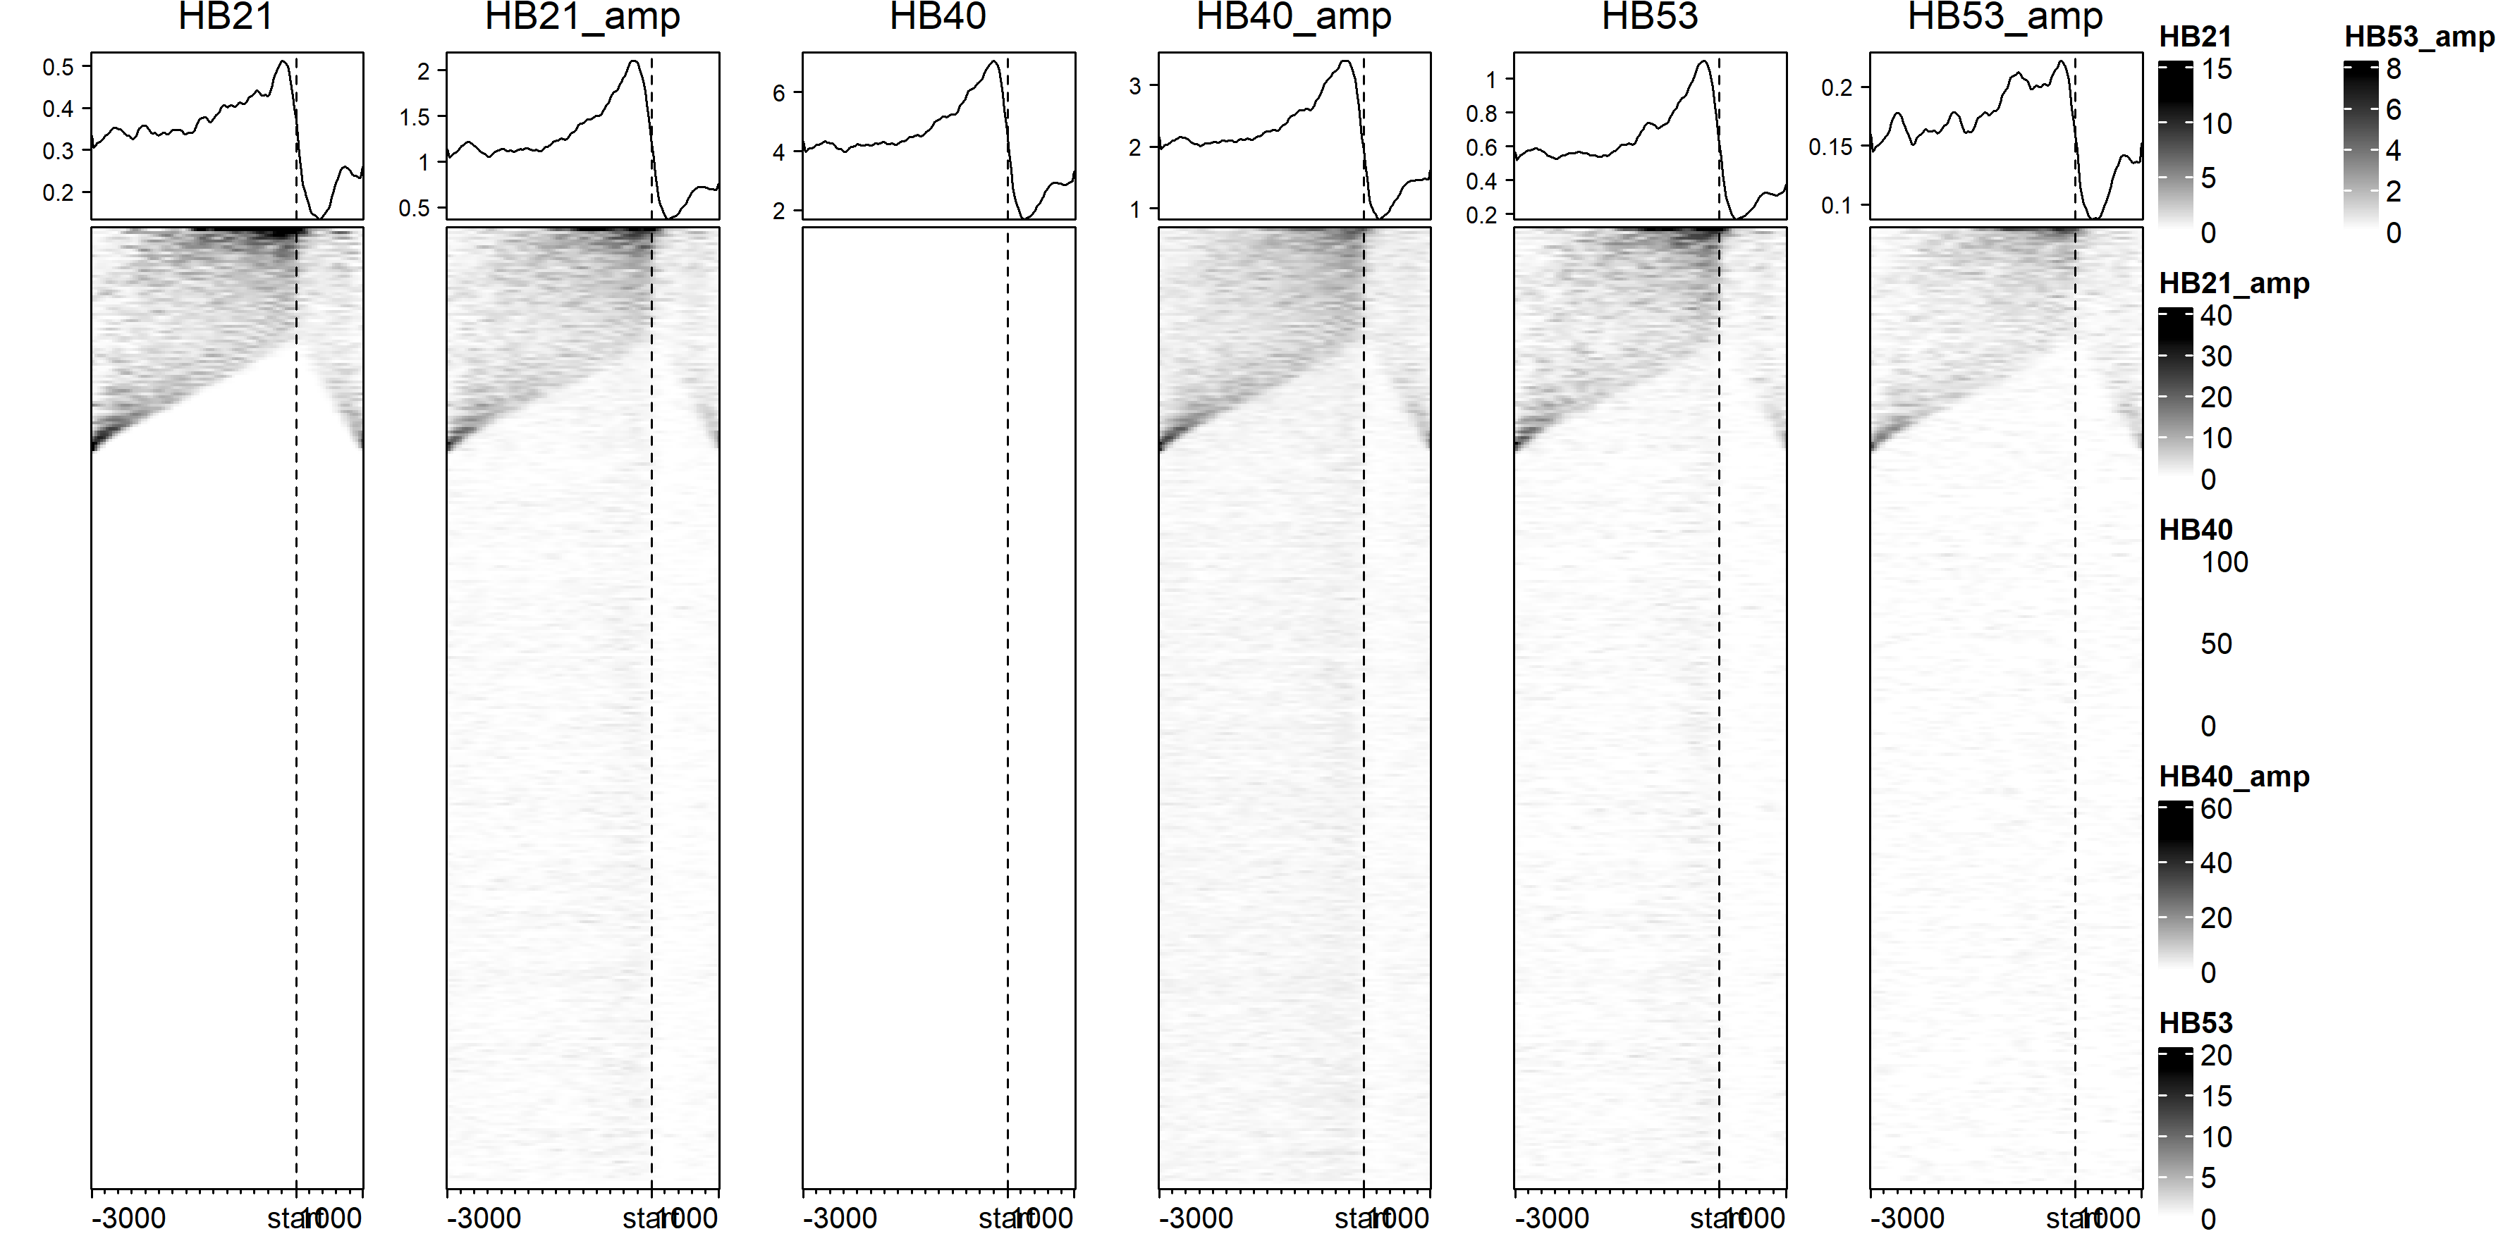

Slide 13
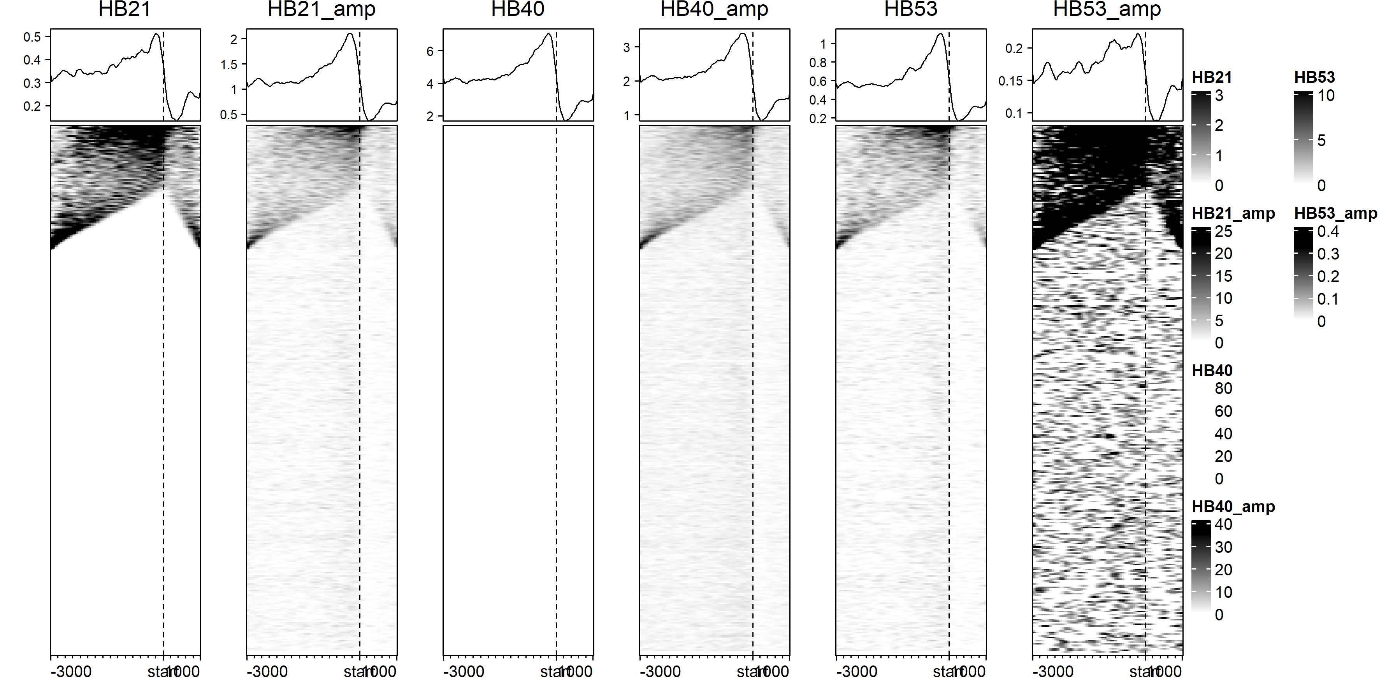

Slide 14
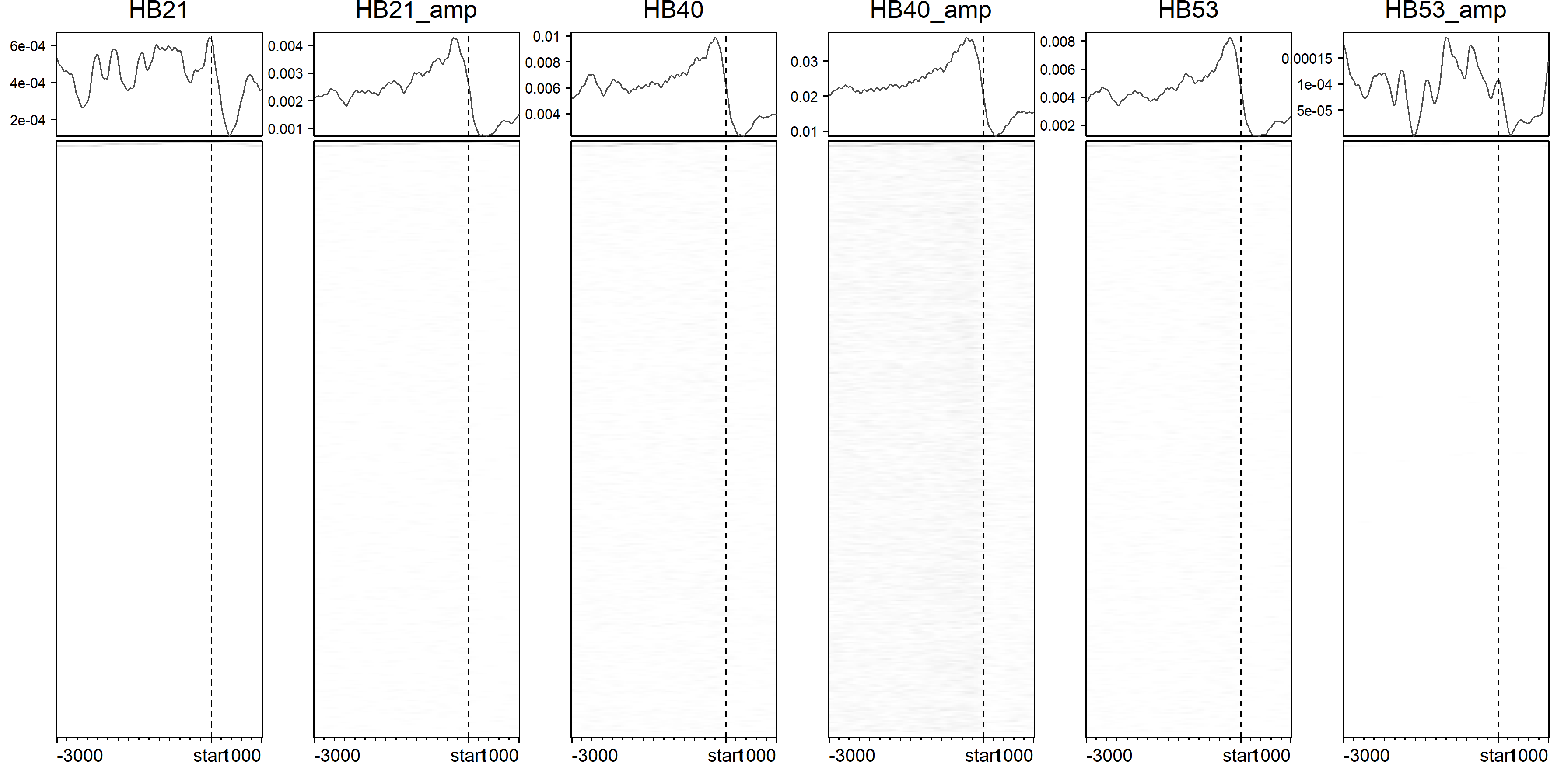
Peaks with score >200

Slide 15
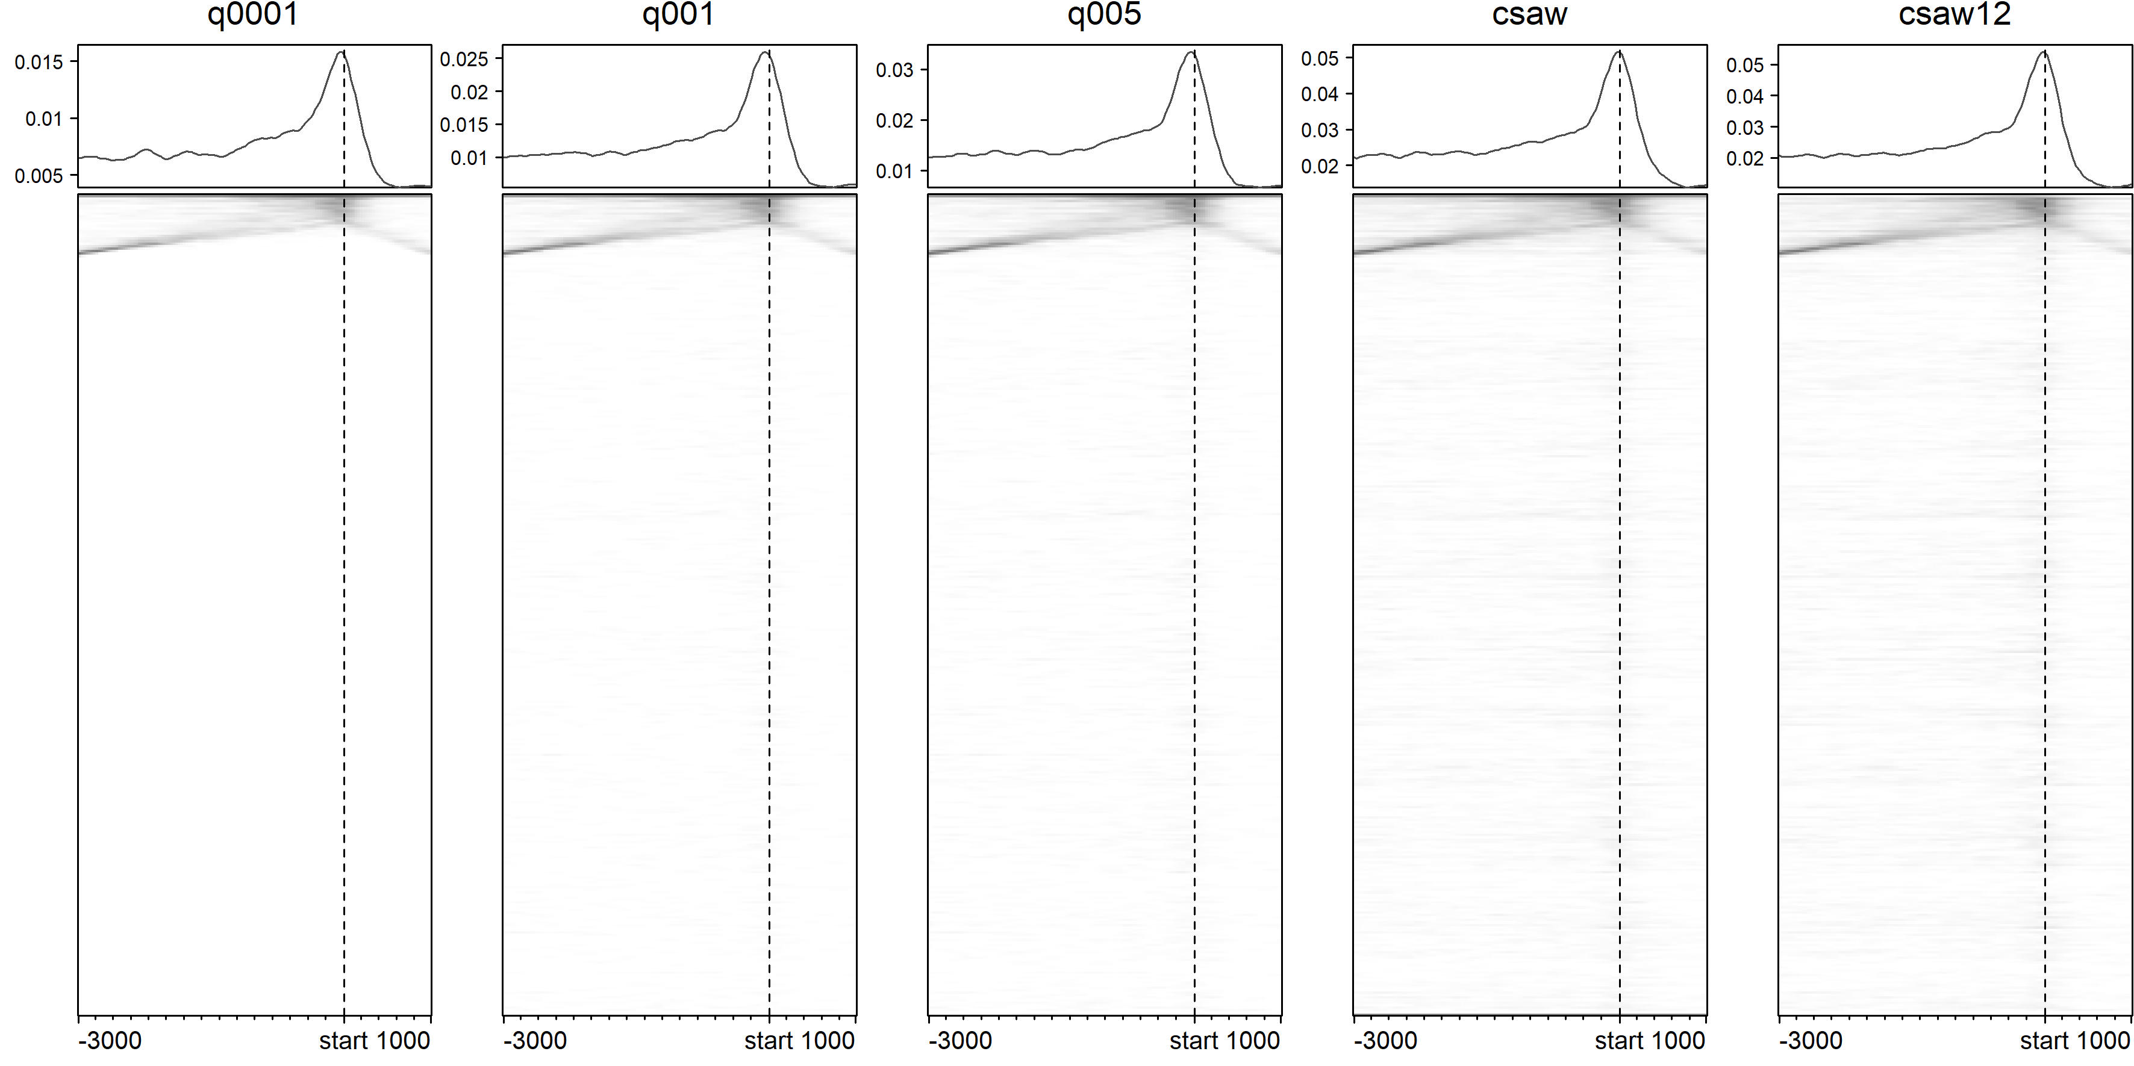

Slide 16
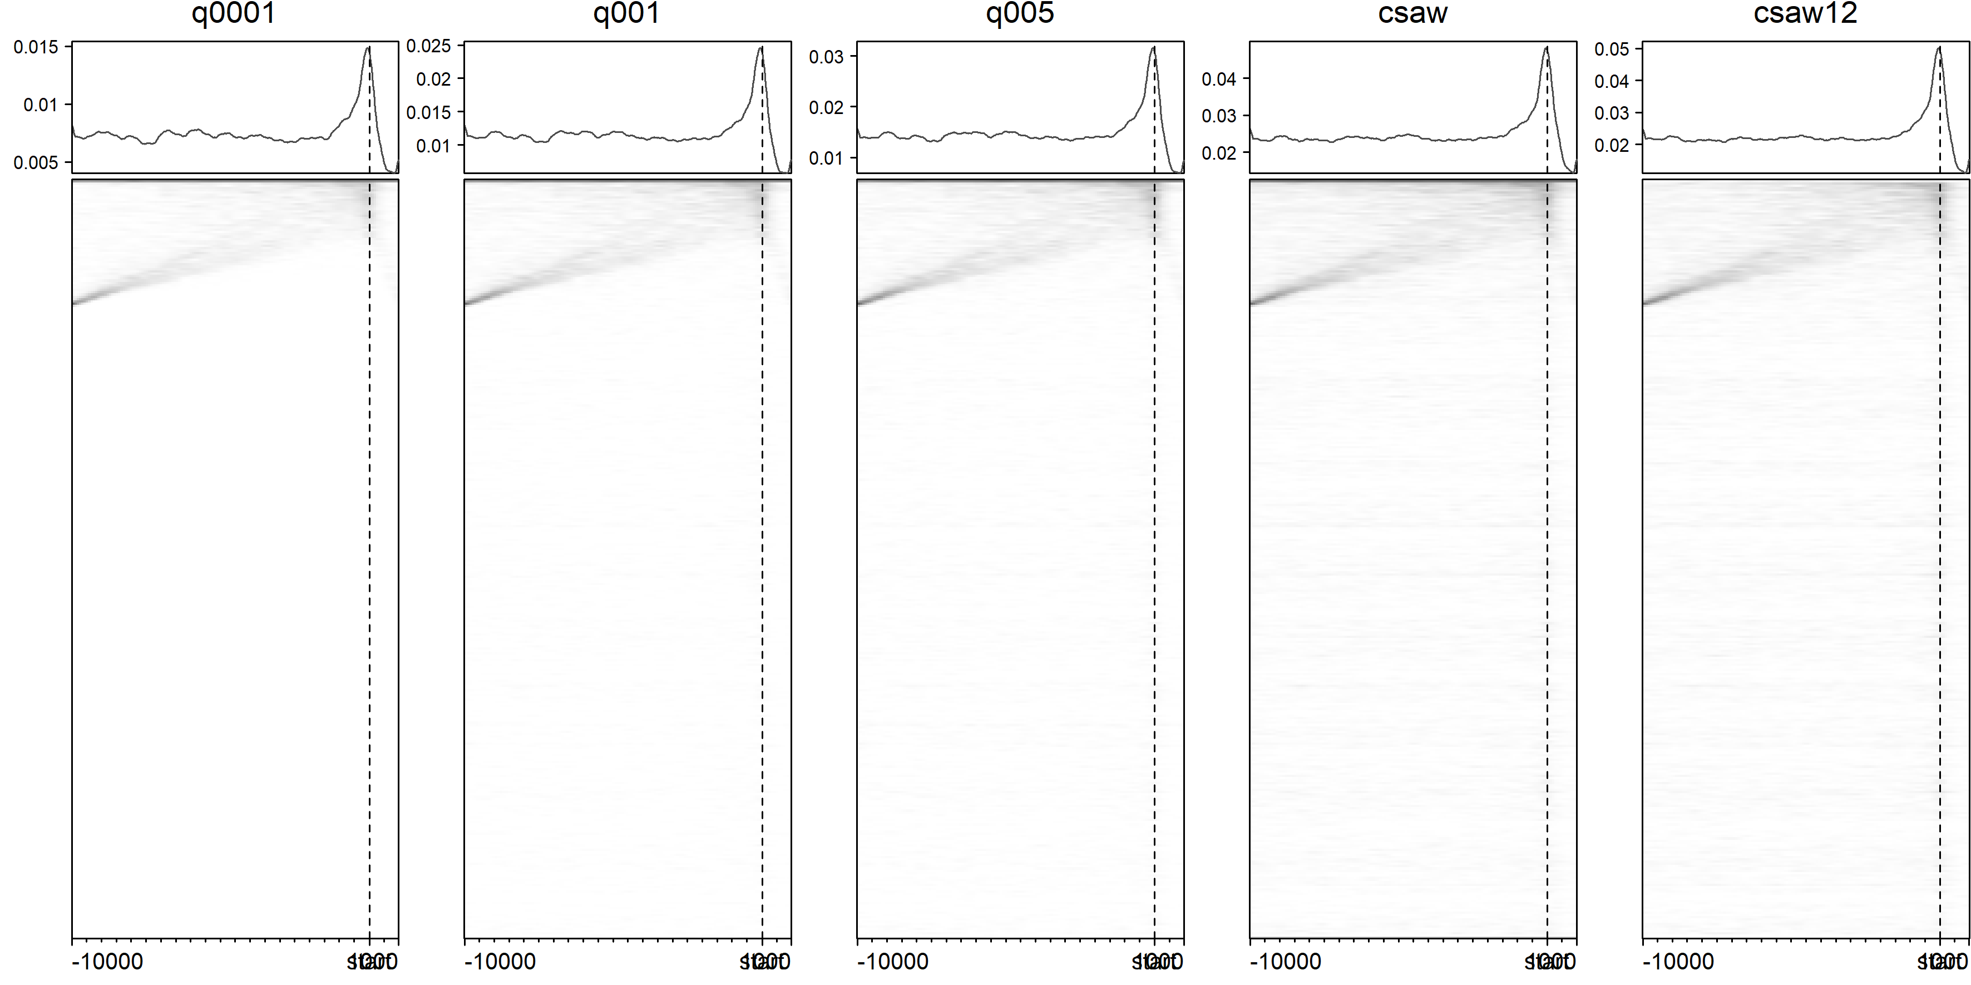

Slide 17
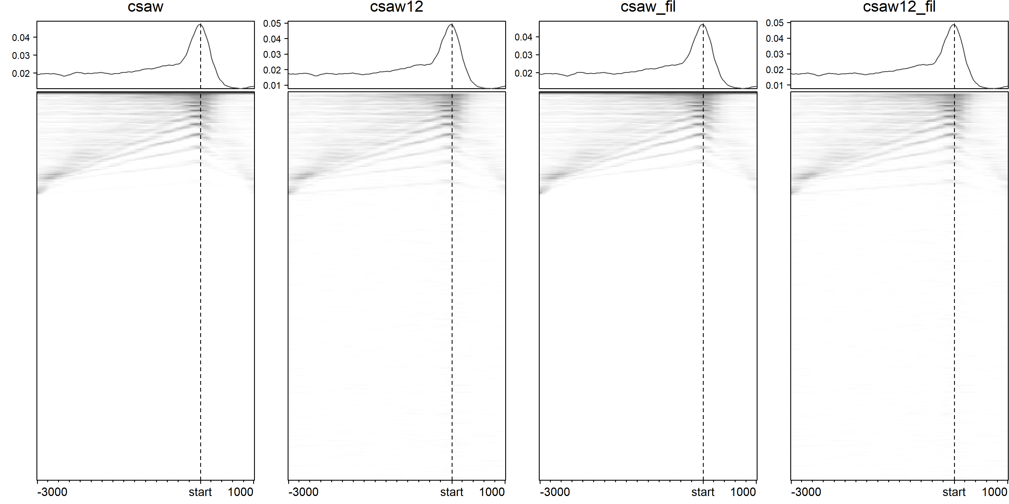
Filtered peaks of 10 bp length

Slide 18
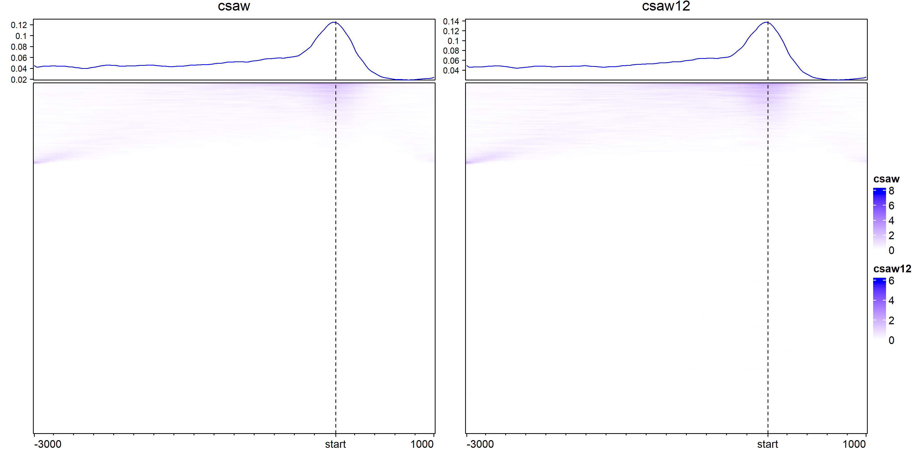
Peak signal

Slide 19
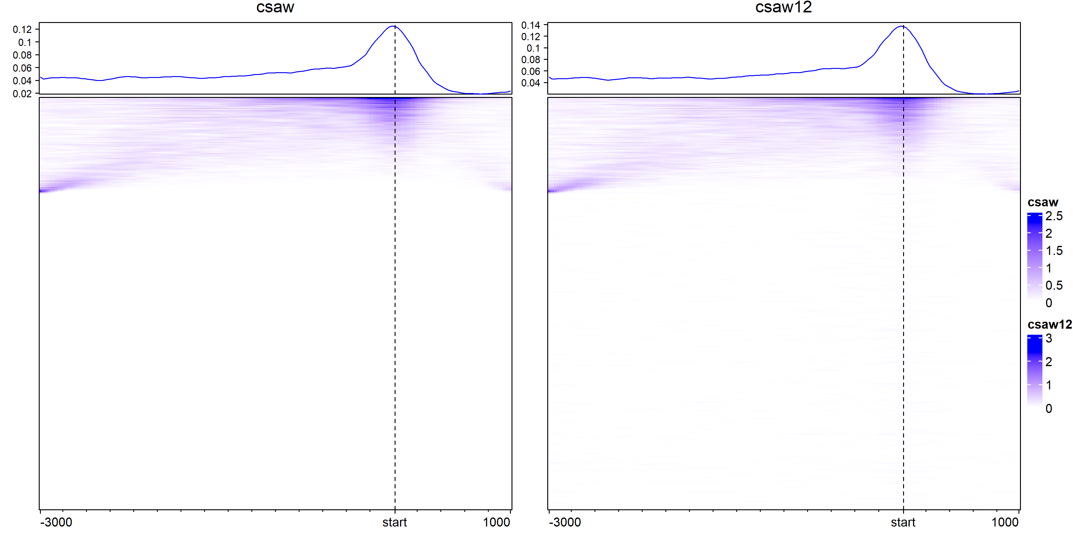
Peak signal with adjusted color scale to top 99% values

Slide 20
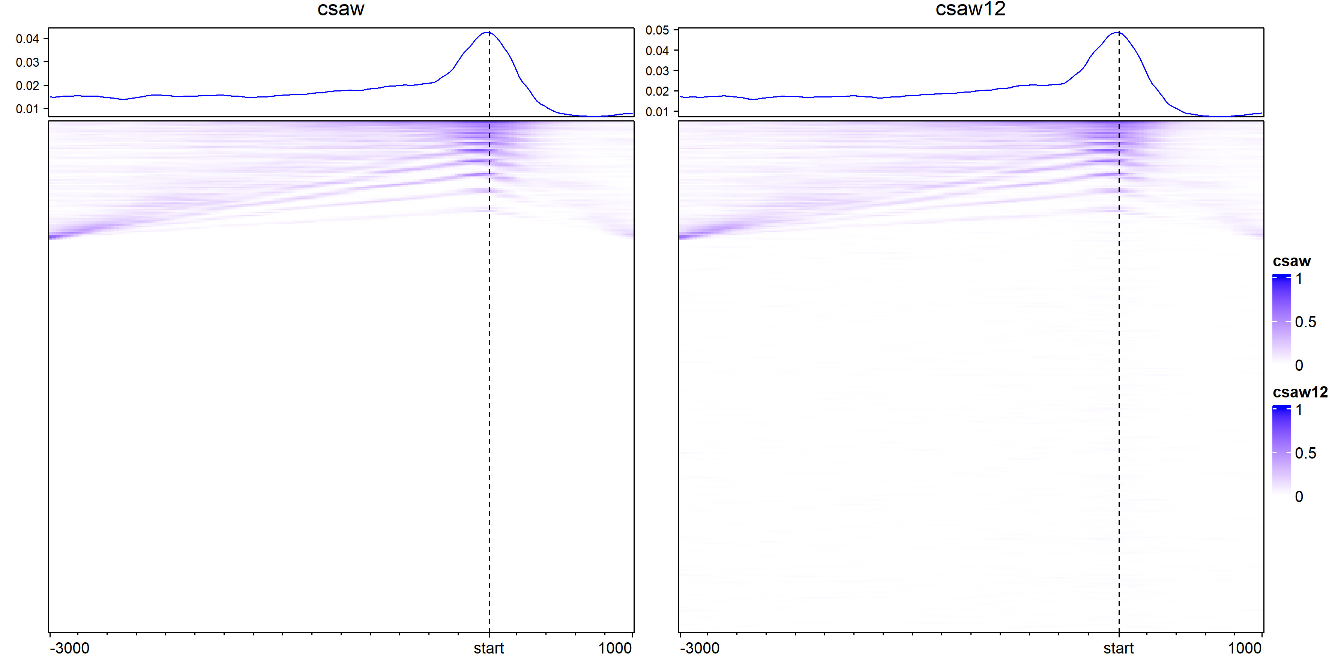
Only peak location reported

Slide 21
